Slide 1
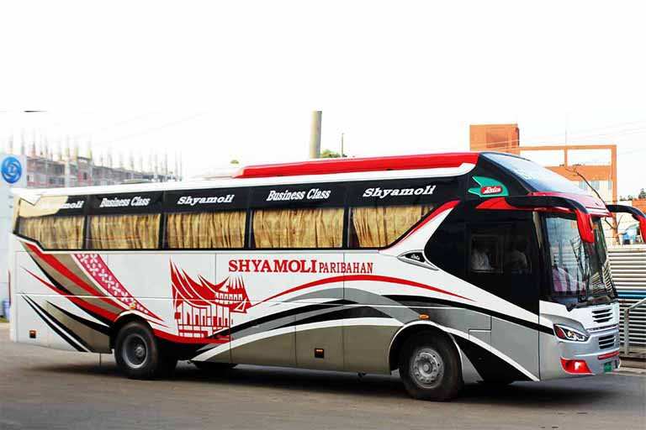
SHYAMOLI
PARIBAHAN
Reliable and Fast Transport

Slide 2
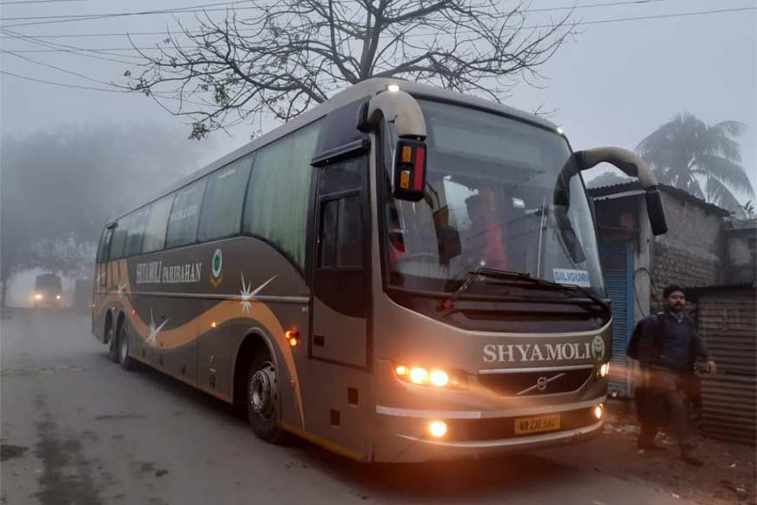
Introduction
One of the leading private passenger transport organizations in Bangladesh.
Founded by Mr. Ramesh Chandra
Ghosh, the company originated in his hometown Pabna in 1973 with only 1 non-air-conditioned bus suggesting the start up stage of the commercial undertaking. Shyamoli Paribahan makes travel easier and more enjoyable for many people.

Slide 3




Marketing Communication System
Digital and Social Media Presence.
Brand Differentiation.
Traditional Marketing Channels.
Customer Service Communication.
Service Quality.
Partnerships and Route Expansion.

Slide 4
Product-Market Expansion Grid
Existing Product, New Market.
Strategic Use of Logistics and Partnerships.
Turnaround of a Falling Route.
Focused Promotion Strategy.
Customer-centric Positioning.

Slide 5
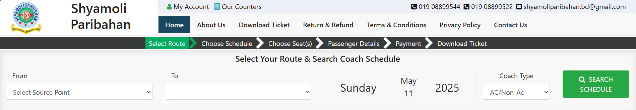
From October 2017 to January 2018, the number of trips and passengers was low.
Holistic Marketing
Customer Value
Integrated Marketing.
Internal Marketing.
Relationship Marketing.
Performance Marketing.
Fast service (only 4 hours)
Clean buses
Friendly staff
Time-saving
Reliable schedule
https://shyamolitickets.com/

Slide 6
High Ticket Price
Future Bridge Problem
Bad Weather
Competition
Future Threats and Weaknesses
Smart Planning
Technology Use
Customer Happiness

Slide 7
Conclusion
In conclusion, the case concerning Shyamoli Paribahan has now been thoroughly examined and resolved. After a careful analysis of the relevant facts, legal considerations, and stakeholder perspectives, a fair and balanced outcome has been achieved. The resolution not only addresses the immediate concerns raised but also paves the way for improved accountability and service standards in the transport sector. Shyamoli Paribahan is expected to take the necessary steps to uphold customer trust, comply with regulations, and ensure safer, more reliable transportation moving forward.

Slide 8
THANK YOU

